Slide 1



ecx.io Frontend Bootcamp — HTML: Semantics 30.06.2021.

Slide 2

Agenda
Recap of Friday Exercise
HTML Semantic elements
[lunch break]
Website structure
Common use-cases

Slide 3


Recap of Friday Exercise

Slide 4
Friday exercise
With everything covered so far structure HTML page with correct tags.
https://github.com/mdn/learning-area/blob/master/html/introduction-to-html/html-text-formatting/text-start.html
2. Create following pages and add navigation between them: - homepage
- add some headings and paragraphs - product list page
- add a list of products with name and short description, and a link to product details page - product details page
- add a product name and some description,
- add the table with detailed information

Slide 5
HTML Semantic elements

Slide 6
HTML Semantic elements
Semantic element clearly describes it’s meaning to both browser and developer.
They clearly define their content.
Examples:
<nav>
<address>
<article>
Non-semantic elements tell nothing about their content.
Examples:
<div>
<span>

Slide 7
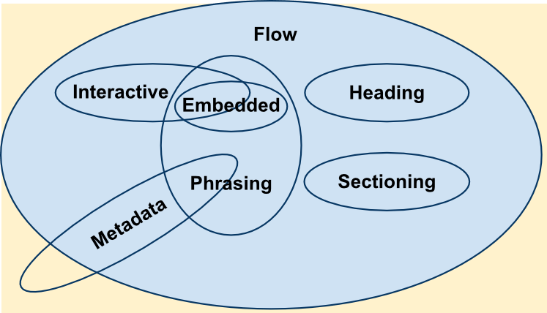
Content categories
Every HTML element is member of one/more content categories.
Content category groups elements that share common characteristics.

Slide 8
Content categories
Metadata content
Elements modify the presentation or behavior of the document, or set up links to other documents
Examples: <link> <meta> <script> <style> <title>

Slide 9
Content categories
Flow content
Broad category that contains all elements going inside the <body>. Elements contain content.
Examples: headings <section> <aside>

Slide 10
Content categories
Sectioning content
Subset of flow content.
Elements create a section in the document outline.
Examples: <article> <section> <aside> <nav>

Slide 11
Content categories
Heading content
Subset of flow content.
Elements define the title of a section.
Examples: <h1> to <h6>

Slide 12
Content categories
Phrasing content
Subset of flow content.
Elements define the text and markup.
Examples: <cite> <code> <em> <sup>

Slide 13
Content categories
Embedded content
Subset of flow content.
Elements import another resource, or insert content from another place.
Examples: <audio> <video> <img> <iframe>

Slide 14
Content categories
Interactive content
Subset of flow content.
Elements defined for user interaction.
Examples: <a> <button> <label> <select>

Slide 15
Content categories
Form associated content
Subset of flow content.
Elements defined for user interaction.
Examples: <button> <label> <select> <fieldset> <input>

Slide 16
Content sectioning elements

Slide 17
Content sectioning elements
Elements organize the document content into logical pieces.
Elements can be used to create an outline of the page content, including header, footer and heading elements to identify sections of content.

Slide 18
Content sectioning elements
Address
Element that indicates that the enclosed HTML provides contact information for a person (or people), or for an organization

Slide 19
Content sectioning elements
Article
Represents a self-contained composition in a document, which can be independently reusable.
Examples: forum post, newspaper article, blog entry, product card.
It can contain any element of the flow content elements.

Slide 20
Content sectioning elements
Aside
Represents a portion of content which is only indirectly related to the content of its nearest sectioning content element.
Frequently used as sidebars.

Slide 21
Content sectioning elements
Footer
Represents a footer for its nearest sectioning content element.
Usually contains info about author of the section, copyright data or links to related documents.

Slide 22
Content sectioning elements
Header
Represents a header for its nearest sectioning content element.
Usually contains the navigation, logo, search form or similar elements

Slide 23
Content sectioning elements
Headings
<h1> to <h6> represent six levels of section headings.

Slide 24
Content sectioning elements
Headings
Heading information is used by browsers to construct a table of contents for the document
They should not be used to just resize text
No heading level should be skipped
Use only one <h1> per page
Note: HTML 5 allows <h1> for every sectioning element, but this is not considered best practice.

Slide 25
Content sectioning elements
Headings
Exercise: check the outline with validator.
https://validator.w3.org
Exercise 2: validate https://ecx.io outline via validator.

Slide 26
Content sectioning elements
Main
Represents the dominant content of the <body>
Consists of content that is directly related to the topic of a document
Content should be unique to document (repeated content such as navigation, logo, etc, shouldn’t be included)
Does not contribute to the document’s outline

Slide 27
Content sectioning elements
Nav
Represents a section with the purpose to provide navigation links
Document can have multiple <nav> elements
Screen readers use the <nav> elements to navigate between the navigational-only content, or the content
It does not have to contain the list element

Slide 28
Content sectioning elements
Section
Generic standalone section of a document, which does not have a more specific semantic element to represent it.

Slide 29
Content sectioning elements
Section
Only to be used if there’s no more specific element to represent the content
e.g. main navigation goes to <nav>, but list of searched product results can go in <section>
If the content represents a standalone, atomic unit, that makes sense as a standalone piece, <article> should be used instead
If the content represent additional info to the main content, <aside> should be used instead
If the content represents the main content area of the document, <main> should be used instead
If used only as a styling wrapper, <div> should be used instead, to not influence the outline

Slide 30
Text content

Slide 31
Text content
Elements can be used to organize blocks of content placed inside the <body>
They identify the purpose or structure of that content, which is important for accessibility and SEO.

Slide 32
Blockquote
Indicated that the enclosed text is a quotation.
Usually rendered visually by indentation.
Source of the quotation can be given with “cite” attribute.

Slide 33
Div
Generic container for flow content.
It has no effect on the content or layout (until styled).
It has no semantic meaning.

Slide 34
Description list
Contains a list of terms and descriptions.
Whenever we want to display key-value pairs.

Slide 35
Figure
Represents the self-contained content.
Can have a caption, provided in <figcaption>.
Usually used for displaying images, diagrams, code snippets.

Slide 36
Hr
Represents a break between paragraph levels.
Examples: change of scene in a story, shift of topic in an article.

Slide 37
Pre
Represents preformatted code.
Rendered exactly as written.
Usually rendered with a monospace font (e.g. for displaying code snippets)

Slide 38
Lists
List of items, either ordered or unordered.

Slide 39
Inline text semantics

Slide 40
Inline text semantics
Such elements are used to define the meaning, structure, or style of a word, line or any piece of text.
Complete list of elements

Slide 41
Anchor
Element which creates a hyperlink to a different web page, file, email address.

Slide 42
Code
Element that displays it’s content styled to indicate the content is a short fragment of code.
Usually rendered in monospace font.

Slide 43
Q
It’s content is a short inline quotation.

Slide 44
Span
Generic inline container for phrasing content.
Does not represent anything semantically.
Can be used to group elements for styling purposes.

Slide 45
Time
Represents a specific point in time.
Can include “datetime” attribute to translate the date into machine-readable format (increases support for SEO).

Slide 46
Strong vs. B
Indicates its content has a strong importance or
urgency.
Usually it will be rendered in bold font type.
<b> will visually give the same result, however, <b> does not have any semantic meaning and screen readers will not identify the importance of its content.

Slide 47
Em vs. I
Indicates its content should be emphasized.
Usually it will be rendered in italic font type.
<i> will visually give the same result, however, <i> does not have any semantic meaning and screen readers will not identify that its content should be emphasized.

Slide 48
Exercises
Notes: - use appropriate document structure - in general, the letter should be marked up as an organization of headings and paragraphs - dates should also have appropriate machine-readable values - acronyms/abbreviations need to be marked up correctly - parts of chemical formulae have to be subscripted/supscripted correctly - for the hyperlinks, use the “http://example.com” as the URL - mark up the university moto with appropriate elements - create a stylesheet file and add a class which will align the content to the right - use HTML validator to validate the solution
Mark up a letter. The letter is a response regarding the application to the university.
Letter source: https://github.com/mdn/learning-area/blob/master/html/introduction-to-html/marking-up-a-letter-start/letter-text.txt
Reference: mdn

Slide 49
Website structure

Slide 50
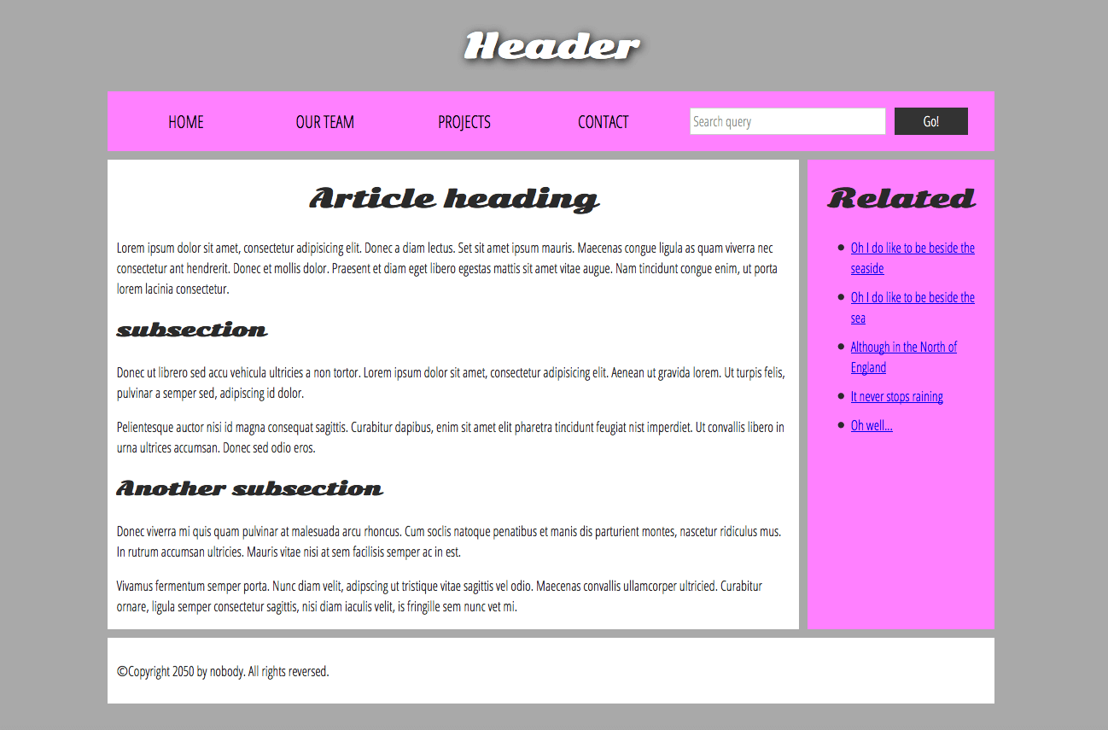
Website structure

Slide 51
Website structure
Header
Usually a big strip across the top
In most cases, stays the same between
pages of the website

Slide 52
Website structure
Navigation
Main navigation, usually a list of links
In most cases, stays the same between
pages of the website
Sometimes part of the header, but from accessibility point of view, better to have it separated

Slide 53
Website structure
Main content
Main area of web page
Gives the main content to the user
Definitely changes among different pages

Slide 54
Website structure
Sidebar
Additional content that describes the main content
Can contain additional links, quotes, ads

Slide 55
Website structure
Footer
Usually a big strip across the bottom
Includes copyright info, contact info or quick links
Place to put common information to it In most cases, stays the same between
pages of the website

Slide 56
Which HTML element to use?

Slide 57
Which HTML element to use?
Answer is not often straightforward, as the visual does not tell the whole story.
We see the colored parts, font size to indicate importance => that will work, but only for one group of users.
Visually impaired people will not notice the difference between colors.
Luckily, in HTML we can mark up the sections of content based on their functionality and purpose.

Slide 58
Which HTML element to use?
<header>
Header
Navigation
Main content
Sidebar
Footer
<nav>
<main>, with <article>
<aside>
<footer>

Slide 59
Content sectioning elements

Slide 60
Main
Content that is unique to this page
Should be used only once per page, preferably directly under the <body>

Slide 61
Article
Block of related content that makes sense on its own, without the rest of the page.
If we remove all other HTML, the content would still make sense to the user.
It can include other semantic elements inside itself.

Slide 62
Section
Should be used for thematic grouping of content, when there is no better semantic element to be used.
Similar to <article>, but is more for grouping parts of page which constitutes one single piece of functionality, while article is quite specific.
Best practice – start the section with a heading.

Slide 63
Aside
Although related to main content, the content of <aside> does not belong to the main flow.
Provides additional info indirectly related to the main content.
Often used for sidebars.
Not allowed to nest additional <aside> inside it.

Slide 64
Nav
Contains primary navigation of the page.
Not allowed to nest additional <nav> inside it.
It can contain multiple levels of menu hierarchy.

Slide 65
Header
Area that usually contains a logo, title and navigation.
Child of <body> that defines the global header of a webpage.
Can be included inside other sectioning element (e.g. <article>) – then it defines a specific header for that section

Slide 66
Footer
Area that usually contains copyright, legal notices or quick links.
Child of <body> that defines the global footer of a webpage.
Can be included inside other sectioning element (e.g. <article>) – then it defines a specific footer for that section

Slide 67
Non-semantic wrappers
They can be used when there is no ideal semantic element to group the content.
Sometimes only needed for styling or JS purposes.
We should only use them when there’s no better semantic (text or block) element to use, or if we don’t want to add any specific meaning to their content.
<div> and <span> elements.
<div> - block level non-semantic element
<span> - inline non-semantic element

Slide 68

Always use the semantic elements, whenever applicable. However, be careful not to ”over-use” them, as well as replace all “<div>”s with “<section>”s.

Slide 69
Exercises
Download the zip file containing all needed assets. It contains: - HTML file to which you need to add the structural markup - CSS file to style your markup (no changes required)
Tasks: 1. Include the CSS file to the html file. 2. Mark up the sections of the page. As you mark them up correctly, they turn their background green.

Slide 70
Common use cases

Slide 71
Common use cases
Let’s go over some examples of identifying the sections of web pages.
Exercise: For each of the websites, try to write down the sectioning structure and verify the outline via HTML validator
https://develop.battle.net
https://news.blizzard.com/en-us
https://careers.blizzard.com/global/en

Slide 72

References
https://developer.mozilla.org/en-US/docs/Web/HTML/Element#content_sectioning
https://developer.mozilla.org/en-US/docs/Web/Guide/HTML/Using_HTML_sections_and_outlines
http://html5doctor.com
https://developer.mozilla.org/en-US/docs/Learn/HTML/Introduction_to_HTML/Document_and_website_structure
https://developer.mozilla.org/en-US/docs/Web/Guide/HTML/Using_HTML_sections_and_outlines

